Slide 1
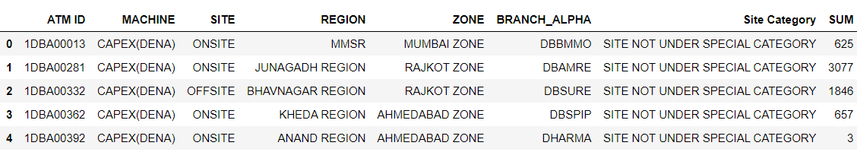
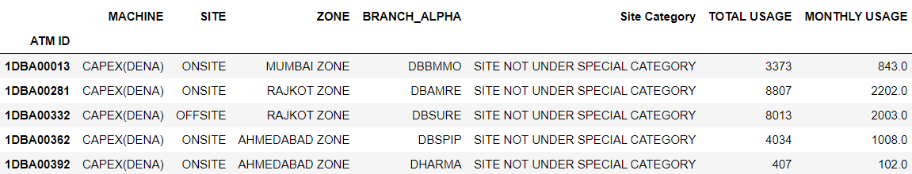
Snapshot of a part of the original dataset (for August) :
There are a few machines which 2 different Region names. For instance, ATM with ID 1DBA00281 (ref. row index 1) has region as JUNAGADH for months August and September, and BHAVNAGAR for October and November. Hence, for time being, Region is being ignored.
The total usage and average monthly usage are calculated for each ATM. Table is as follows.

Slide 2
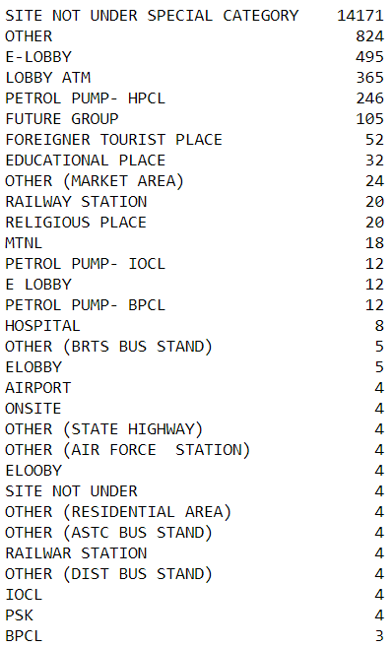
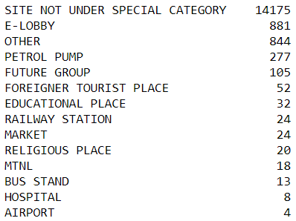
Cleaning of Site Categories :

Slide 3
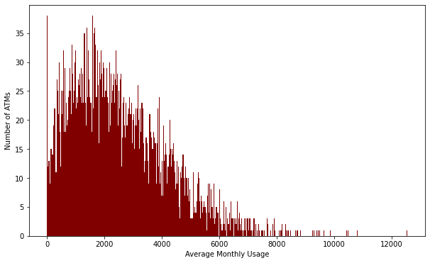
Maximum number of ATMs are used around 2000 times.
Few ATMs are utilized as much as 6000 times or more, in a month.

Slide 4
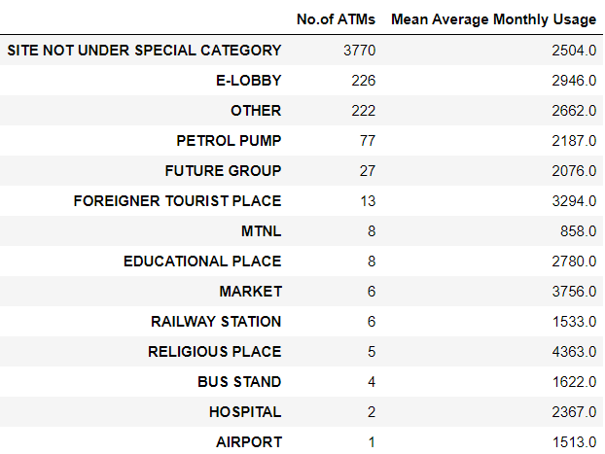
Maximum average usage of around 4363 is observed in 5 ATMs categorized under Religious Place.

Slide 5
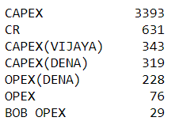
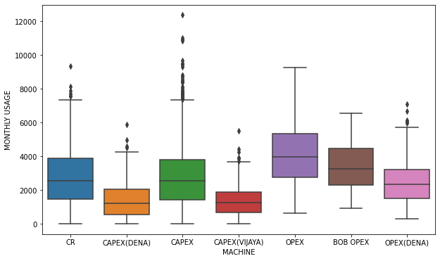
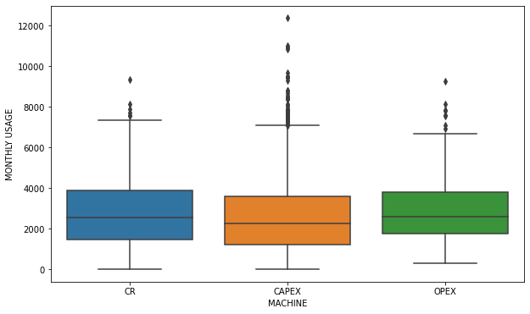
Classification with respect to Machine Types :
Machine Type seems to have no effect on the monthly usage.
CAPEX machines have a wider range of monthly usage going over 12000 times a month.

Slide 6

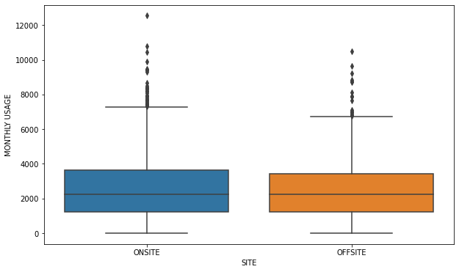
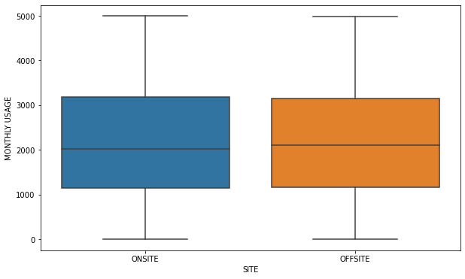
Classification with respect to Site Type :
For all machines
For machines with maximum usage of 5000
Site type has no differential effect on the average monthly usage.

Slide 7
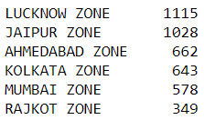
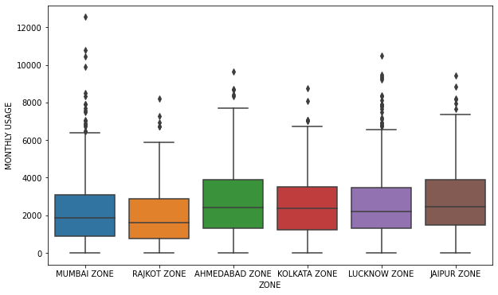
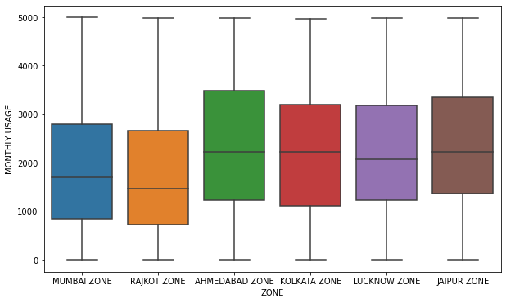
Classification with respect to Zones :
For all machines
For machines with maximum usage of 5000
Zones seem to have no differential effect on the average monthly usage.

Slide 8
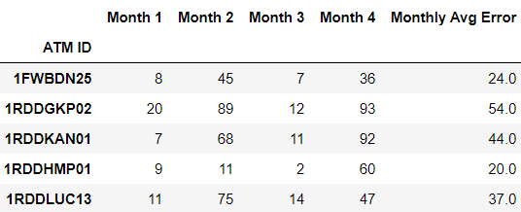
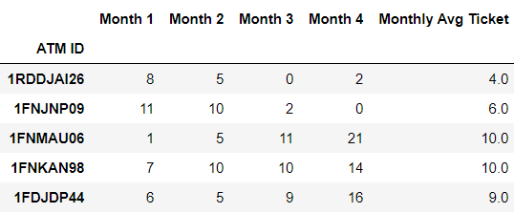
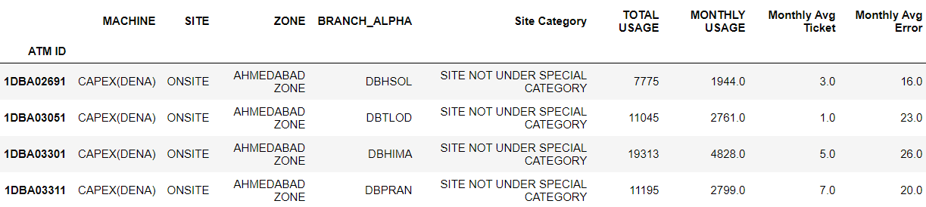
Monthly Average Errors (Priority 1) :
Monthly Average Tickets (SLM/FLM) :
There are 3958 ATMs.
There are 4020 ATMs.
The three datasets are merged. We have 3271 common ATMs.

Slide 9
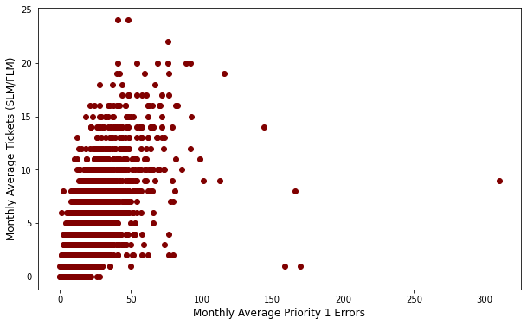
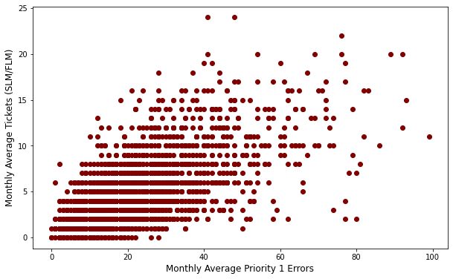
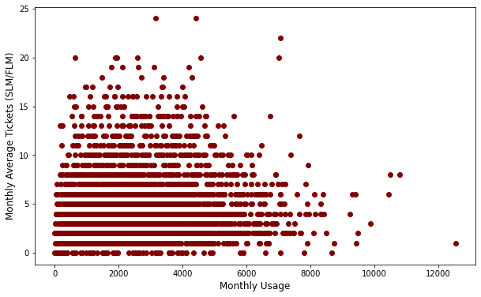
Fig. 1
Fig. 2
Fig. 3
Fig. 1 : Plot between average monthly errors and average monthly tickets for all machines.
Fig. 2 : Same plot for machines with less than 100 average monthly errors.
There seems to be a weak positive relation between priority 1 errors and SLM/FLM tickets
Fig. 3 : No apparent relationship between usage and number of tickets.

Slide 10
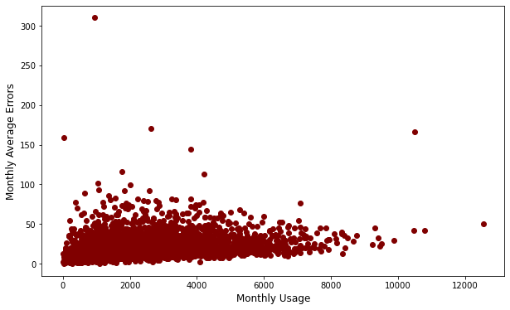
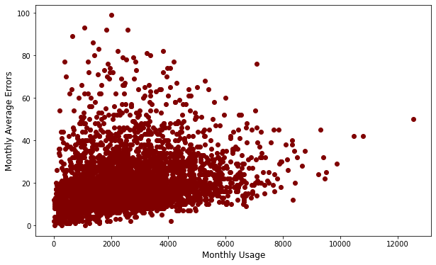
For all machines
For machines with maximum 100 average monthly error count
Very weak positive relationship. Not so relevant.

Slide 11
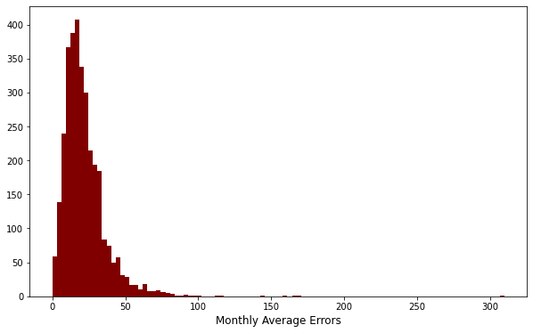
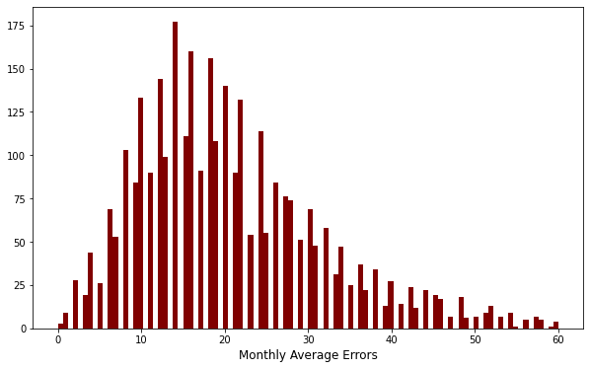
For all machines
For machines with maximum 60 average monthly error count
Maximum ATMs have around 25 errors in a month.
Only a few ATMs have average monthly error count above 80.

Slide 12


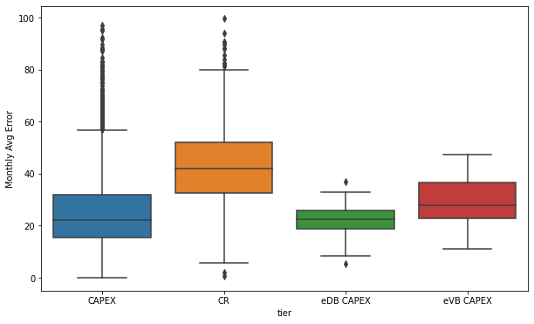
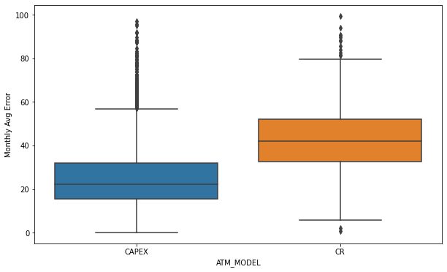
Classification with respect to Machine Types :
OPEX machines have not been recorded in Error and Maintenance files. They only have machine types as CAPEX and CR (Cash Recycler).
There are more errors in case of the Cash Recyclers, with the median number of errors differing by almost 20.

Slide 13
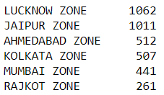

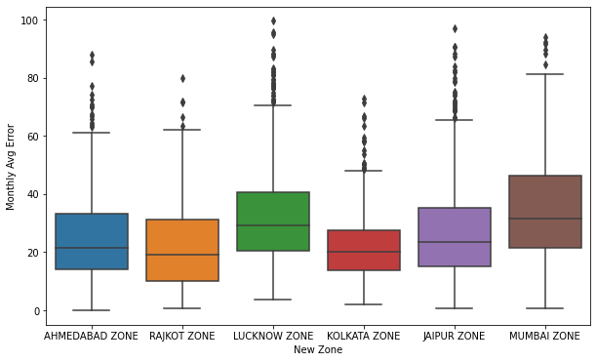
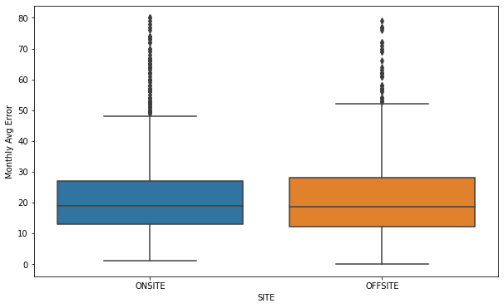
Classification with respect to zones :
Classification with respect to Site types :
Lucknow and Mumbai have comparable ranges, while the rest have lower counts.
Overall, there is not much effect of zones on the error count
Site type doesn’t seem to have much of a differential effect on the average monthly error.

Slide 14
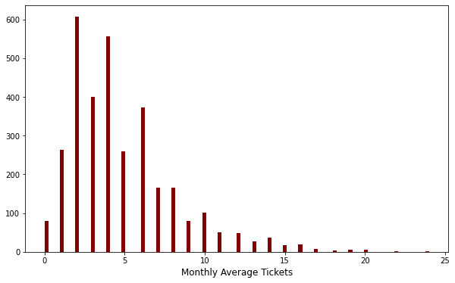
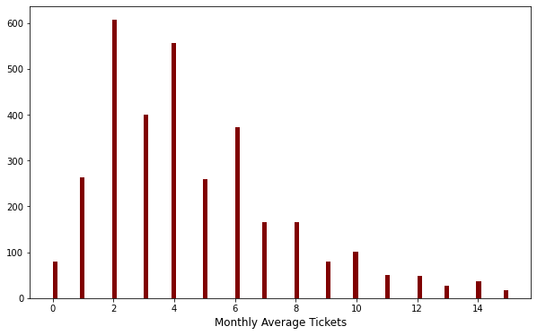
For all machines
For machines with maximum 15 average monthly error count
Maximum ATMs raise an average of 2 or 4 tickets in a month.
Only a few ATMs have average monthly error count above 15.

Slide 15
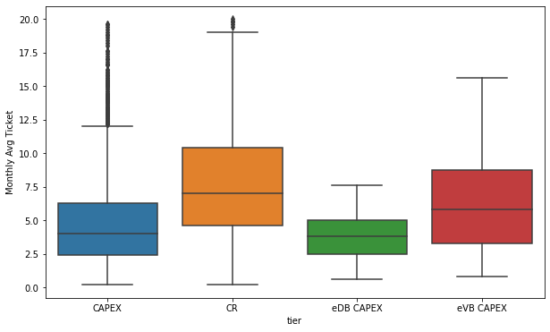
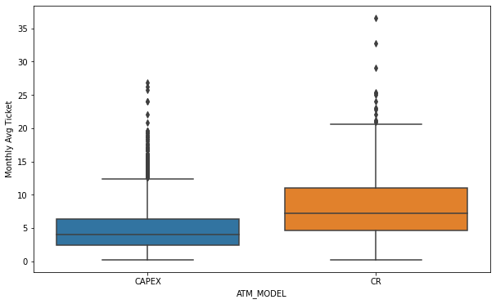
Classification with respect to Machine Types :
There are a few more maintenance tickets in case of the Cash Recyclers as compared to CAPEX machines, which have a maximum average number of tickets as almost 28, as opposed to CR’s 35.

Slide 16
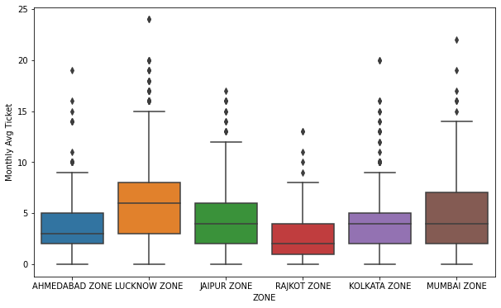
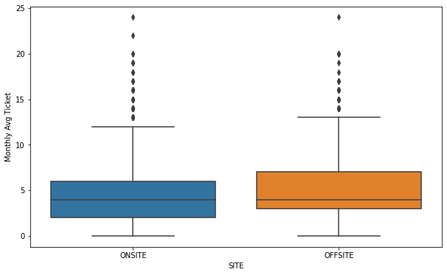
Classification with respect to zones :
Classification with respect to Site types :
Lucknow has the maximum range of tickets. And Rajkot has fewer tickets. This is due to their frequency of occurrences.
Overall, there is not much effect of zones on the tickets.
Site type doesn’t seem to have much of a differential effect on the average monthly tickets.

Slide 17

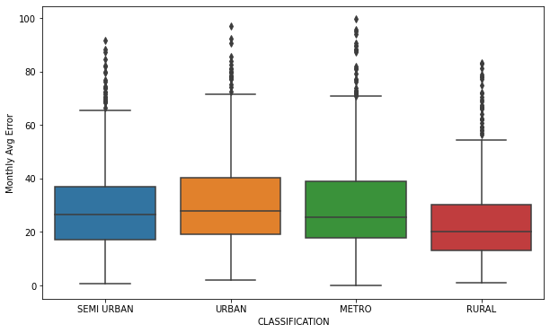
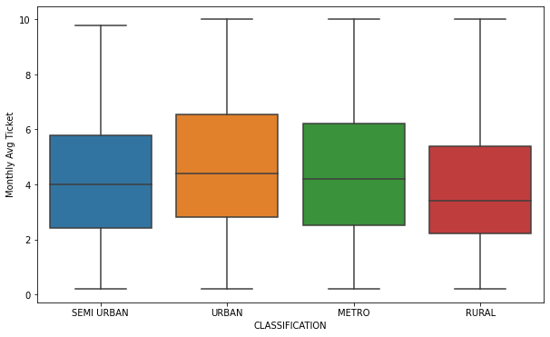
Classification with respect to type of geographical region:
Geographical area doesn’t seem to have much of a differential effect on the monthly average tickets and the errors.

Slide 18
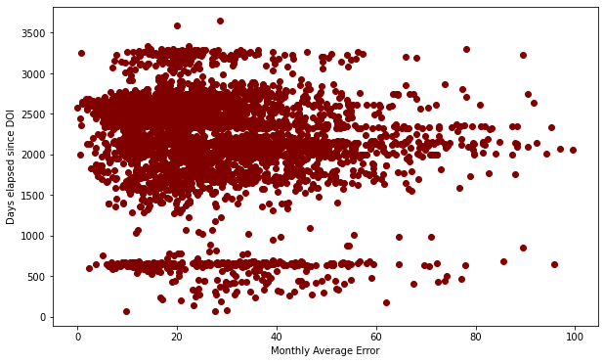
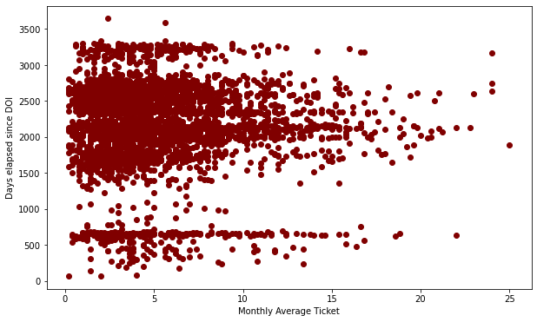
We have the dates of installation for each machine. From this, we may calculate the age (in terms of days) of the machines and observe if there is any relationship between age of a machine and the average error/ticket count.
There is clearly no association evident from the plots.

